Slide 1
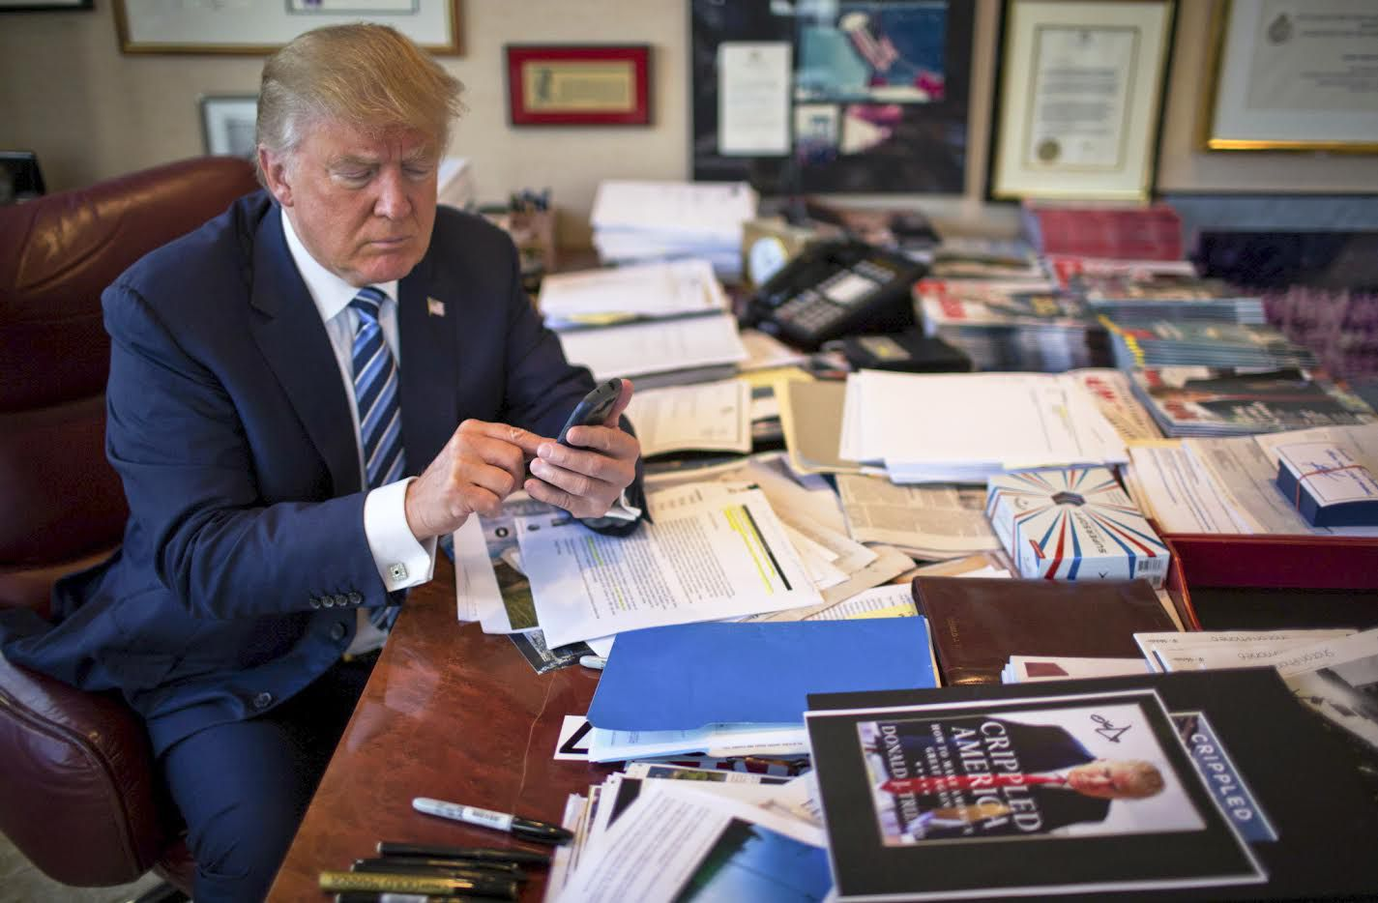

Popular Tweet Times of Donald J. Trump and Common Rhetoric
Adrian Sandoval-Vargas

Slide 2
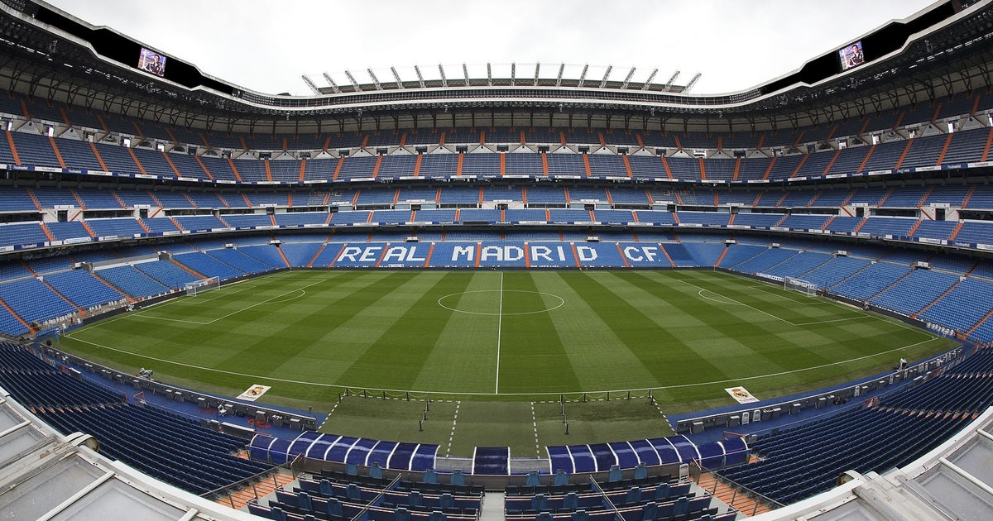
Popular Players in European Football
Adrian Sandoval-Vargas

Slide 3






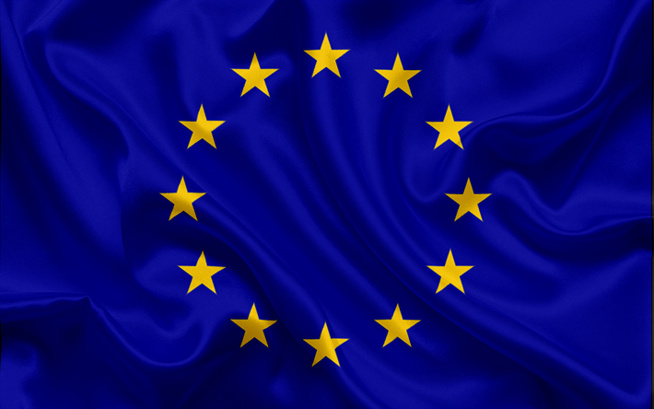
Leagues

Slide 4
Data
Fetching
@LaLiga, @premierleague, @Championsleague
Twitter
Limits ~3,234 tweets
Top Tweeters
Premier league (9/12/2019 – 12/04/2019)
La Liga (8/25/2019 – 12/04/2019)
Champions League (5/7/2019 – 12/04/2019)

Slide 5
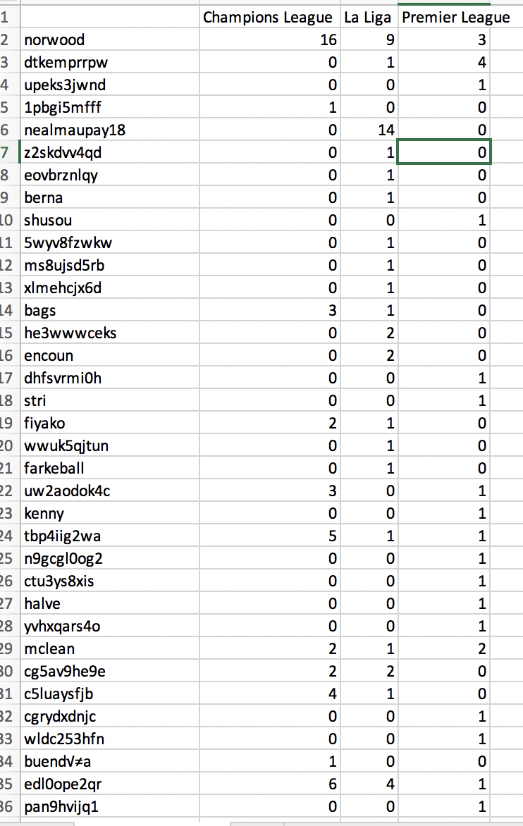
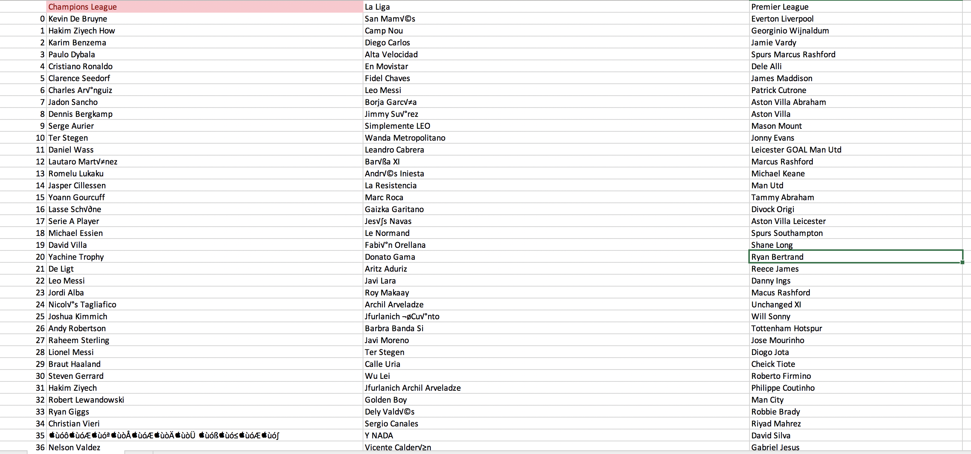
Data

Slide 6

Back To Donald J. Trump
Fetching
@realDonaldTrump
Twitter
158 Tweets (idk why it limits me, National Security?)
No Retweets

Slide 7
Tools
Tweepy
Library to fetch api calls to twitter
Standard python data processing libraries (nltk, sklearn)

Slide 8
Data
Extracted in utf-8
For handling need to decode back to ascii
Date text 0 2019-12-05 03:50:35 ....”I would like to have the Attorney General... 1 2019-12-05 03:50:35 When I said, in my phone call to the President... 2 2019-12-05 00:03:14 Just read the best Maureen Dowd column, in the... 3 2019-12-04 22:43:19 .@NATO has now recognized SPACE as an operatio... 4 2019-12-04 22:36:31 The Fake News Media is doing everything possib... .. ... ... 154 2019-11-20 19:04:30 I WANT NOTHING! https://t.co/KKUfwSIRAi 155 2019-11-20 18:57:07 ....”I WANT NOTHING! I WANT NOTHING! I WANT NO... 156 2019-11-20 18:57:06 Impeachment Witch Hunt is now OVER! Ambassador... 157 2019-11-20 18:45:36 We join families of Kevin King &amp; Tim Weeks... 158 2019-11-20 18:03:40 https://t.co/HbgEgZsPZ9

Slide 9
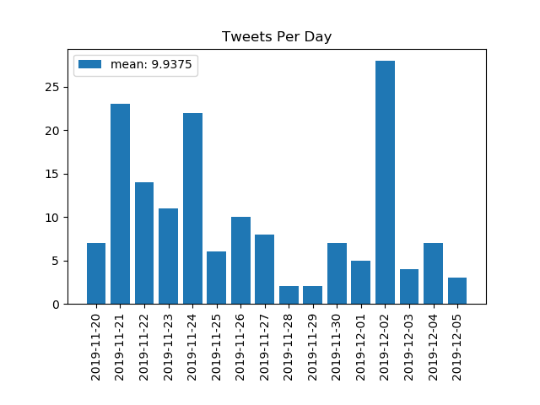
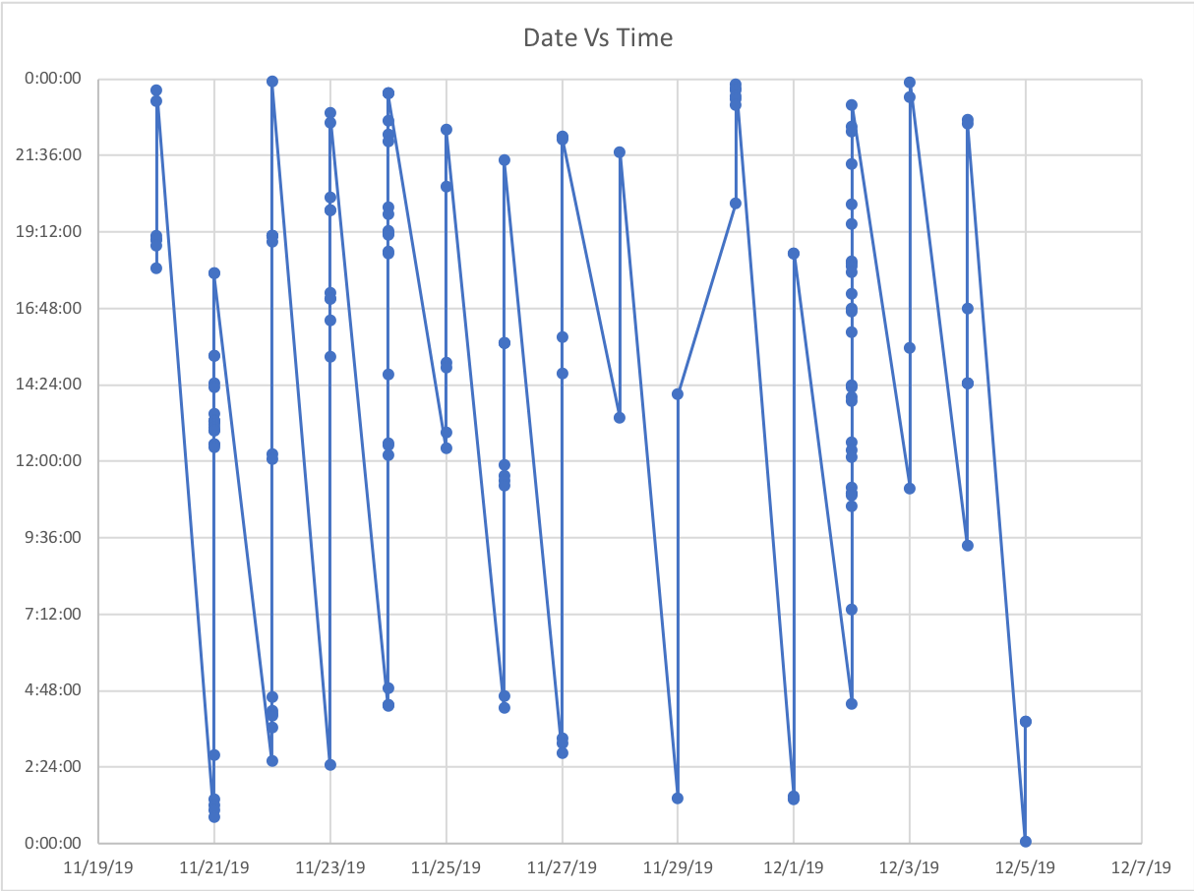
Data - Time

Slide 10
Data - Rhetoric
Extracted in utf-8
For handling need to decode back to ascii

